Slide 1
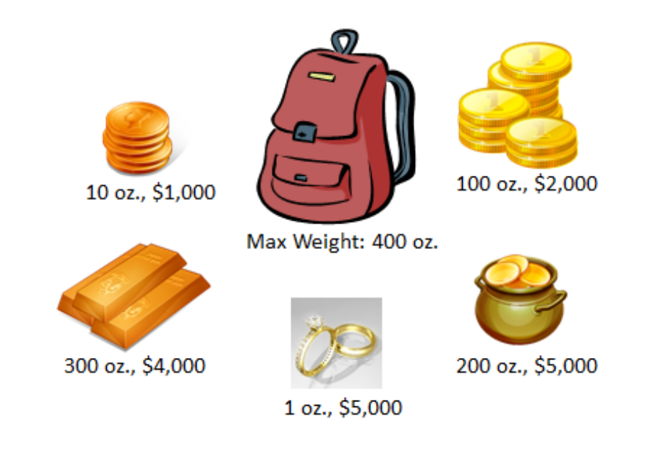
Knapsack Problem
By Franzi Brändle, Patrick Rohmann, Philipp Fukas, BhAskar Majumder and Farina Kock

Slide 2
Structure of our Knapsack Algorithm
Algorithm
Neighbourhood
swap
Hill Climbing (HC)
transposition
swap
First Choice Hill Climbing (FCHC)
transposition

Slide 3
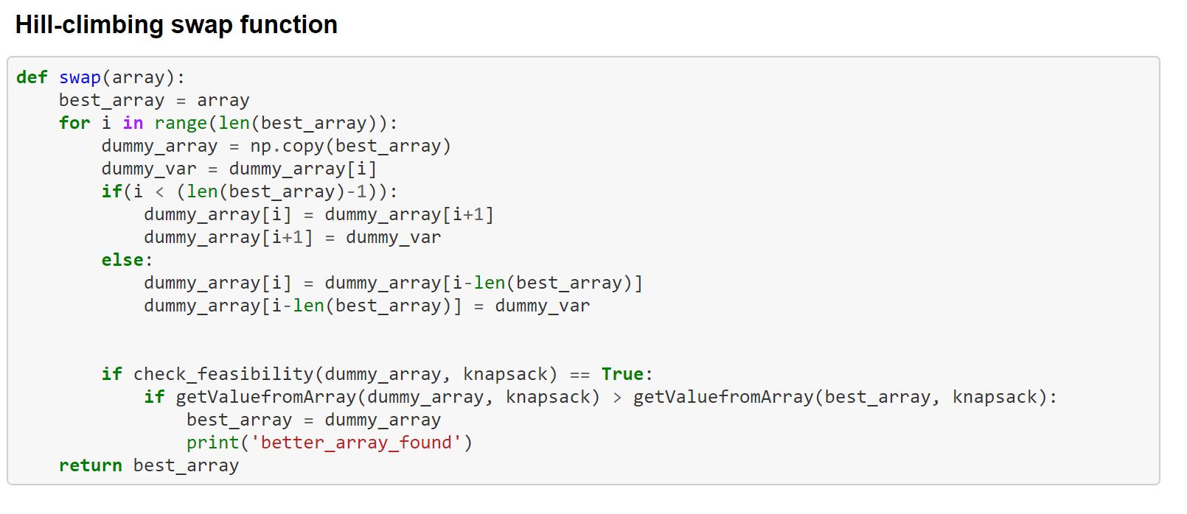
Swap Function
Swap with neighbour in each loop
Break if FCHC
Check better and feasible solution

Slide 4
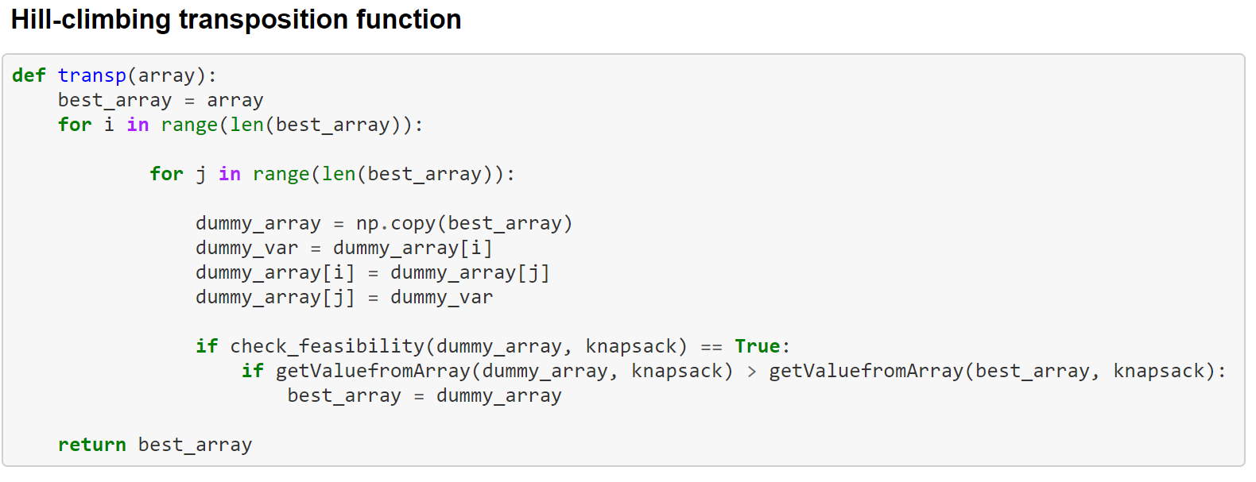
Transposition Function
Swap with arbitrary position for each loop
Break if FCHC
Check better and feasible solution

Slide 5
Results
Run | Algorithm | Neighbourhood | Iteration | Value | Time (ms) | Time per iteration
1 | HC | swap | 2 | 10,000 | 0.015625 | 0.0078125
 | FCHC | swap | 2 | 12,000 | 0.015627 | 0.0078135
 | HC | transposition | 2 | 10,000 | 0.015633 | 0.0078165
 | FCHC | transposition | 1 | 7,000 | 0.015598 | 0.007799
2 | HC | swap | 2 | 10,000 | 0.031214 | 0.015607
 | FCHC | swap | 1 | 13,000 | 0.015624 | 0.007812
 | HC | transposition | 1 | 12,000 | 0 | 0
 | FCHC | transposition | 3 | 12,000 | 0.015589 | 0.0077945
3 | HC | swap | 2 | 5,000 | 0.03125 | 0.0156025
 | FCHC | swap | 1 | 13,000 | 0.015625 | 0.0078125
 | HC | transposition | 2 | 5,000 | 0.015626 | 0.007813
 | FCHC | transposition | 2 | 10,000 | 0.015611 | 0.0078055

Slide 6
Results for 100 iterations

